Slide 1

Algorithms and Data Structures
Unit 1 – Introduction

Slide 2
Outline
Course organization
Recap of algorithms: Exhaustive enumeration
Recap of algorithms: Gradient descent
Recap of algorithms: Merge sort
Data structures and algorithms
Exercise

Slide 3
Course organization

Slide 4

Lecturer
Name: | Ingo Frommholz
Email: | Ingo.frommholz@modul.ac.at
Office Hours: | By Appointment (online & offline)
Office: | 3.08

Slide 5
Course context
BSc Applied Data Science
Module: Fundamentals of Data Science and Engineering
Some other courses from this module:
Fundamentals of Computer Science and Programming
Database Management and Design
Foundations of Artificial Intelligence
Fundamentals of Web Programming and Application Development
…
But also:
Legal Aspects of Data Science
Societal and Ethical Impacts of Data Science
...

Slide 6
Course goals
Learn about:
Basic data structures
Stacks, queues
Trees, graphs
Hash tables
Advanced algorithmic techniques
Randomized, greedy algorithms
Famous data science algorithms
Decision trees, K-means, PageRank, Apriori
Understand:
Usage of data structures
Advanced algorithmic thinking
How to implement modern algorithms in Python
Additionally:
Student goals: to pass the examination
Bonus goal for all: to have fun ☺

Slide 7
Course workload
We will have 3 academic hours every week
These are 2 hours and 15 minutes
Mondays: 12:30 – 15:00 (also: Tuesday April 1st, 14:00 – 16:30)
You will earn 6 ECTS points for the course
This amounts to 6 x 25h = 150h of work
Lectures: 14 x 3h = 42h
Remaining 108h:
Homework: 7 x ~10h ≅ 70h
Preparation for the exam: 38h

Slide 8
Grading
Homework:
Mathematical examples
Programming exercises
Final oral exam:
You will need to answer questions and solve smaller problems
In-class participation:
We will have smaller exercises and problems to solve during class
Questions
Most important: your own participation!
For in-class participation: you need a laptop with installed requirements!

Slide 9
Grading
Final oral exam: 33%
Homework: 34%
In-class participation: 33%
% | Grade
90 - 100 | 1 (Excellent)
80 - 89 | 2 (Good)
70 - 79 | 3 (Average)
60 - 69 | 4 (Sufficient)
< 60 | 5 (Fail)

Slide 10
Academic Misconduct
There will be zero tolerance to any form of academic misconduct
Fraud
Cheating
Plagiarism
Fabrication of material or data
Plagiarism includes:
Plagiarism of text
Plagiarism of source code
You can discuss the homework with other students
But each student has to submit their own work and only their work!
More information in regulations
Zero tolerance: Zero points → Negative grade

Slide 11
Course schedule
Unit | Topic | Homework | Date
1 | Introduction & Heapsort | - | 03. 03. 2025
2 | Quicksort & Randomized Algorithms | Math./Prog. | 10. 03. 2025
3 | Elementary Data Structures I | - | 17. 03. 2025
4 | Elementary Data Structures II | Math./Prog. | 24. 03. 2025
5 | Repetition & Practice Unit | - | 31. 03. 2025
6 | Hash Tables | Math./Prog. | 01. 04. 2025
 | EASTER BREAK (no lecture 07.04.2025)
7 | Trees | - | 28. 04. 2025
This is a substitute session!
The deadlines for the homeworks will be announced in Moodle!

Slide 12
Course schedule
Unit | Topic | Homework | Date
8 | Greedy Algorithms | Math./Prog. | 05. 05. 2025
9 | Graphs I | - | 12. 05. 2025
10 | Graphs II | Math./Prog. | 19. 05. 2025
11 | Network Analysis | - | 26. 05. 2025
12 | Clustering | - | 02. 06. 2025
13 | Classification | Math./Prog. | 16. 06. 2025
14 | Final examination | - | 23. 06. 2025
The deadlines for the homeworks will be announced in Moodle!

Slide 13
Course logistics
Moodle: https://moodle.modul.ac.at/course/view.php?id=7445
Announcements: https://moodle.modul.ac.at/mod/forum/view.php?id=103739
Q&A Forum: https://moodle.modul.ac.at/mod/forum/view.php?id=106477
Slides
Python notebooks
Literature:
Algorithm Design, Jon Kleinberg and Eva Tardos
Introduction to Algorithms, Thomas Cormen, Charles Leiserson, Ronald Rivest
Data Structures and Algorithms in Python, Roberto Tamassia, Michael Goldwasser, Michael Goodrich

Slide 14
Question policy
Interrupt me immediately ☺ and ask any question
Ask after the lecture
Make an appointment for office hours
Moodle forum:
Check for similar questions
Post a question
Write an email
Write an MS Teams message

Slide 15
Recap of algorithms: Exhaustive enumeration

Slide 16
Square root
„How to“ (recipe) compute the square root of a number
Example 1: A simple (naive) recipe for computing the square root of a number x.
Start by a guess g being equal to 0.
If g ⋅ g is close to x, stop and say that g is the answer.
Otherwise create a new guess by adding step s equal to 0.1 to g, i.e., g + 0.1.
Using this new guess (we call it again g), repeat the process until g ⋅ g is close enough to x.

Slide 17
Algorithm
Description of the method:
Sequence of simple steps
Flow of control that specifies when each step is executed
Such a description is called an algorithm
Definition 1: An algorithm is a finite list of instructions that describe a computation that when executed on a provided set of inputs will proceed through a set of well-defined states and eventually produce an output.

Slide 18
Square root algorithm
Finite list of instructions describing a computation
State
Input
Example 3: Let us identify the basic algorithm components in a simple recipe for computing the square root of a number x.
Start by a guess g being equal to 0.
If g ⋅ g is close to x, stop and say that g is the answer.
Otherwise create a new guess by adding step s equal to 0.1 to g, i.e., g + 0.1.
Using this new guess g, repeat the process until g ⋅ g is close enough to x.
Instruction
Output
State
State
Instruction
State
Instruction
Instruction
Definition 1: An algorithm is a finite list of instructions that describe a computation that when executed on a provided set of inputs will proceed through a set of well-defined states and eventually produce an output.
Remark 1: This algorithmic technique is called guess and check. In fact, it is a special variant of guess and check called exhaustive enumeration (brute force). We enumerate all possibilities until we get the right answer or exhaust the space of possibilities.

Slide 19
Recap of algorithms: Gradient descent

Slide 20
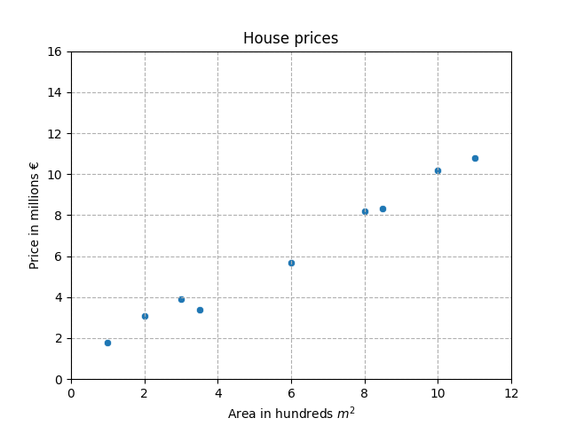
Least squares
We collected some pairs of data and would like to fit a line to the data (training set)

Slide 21
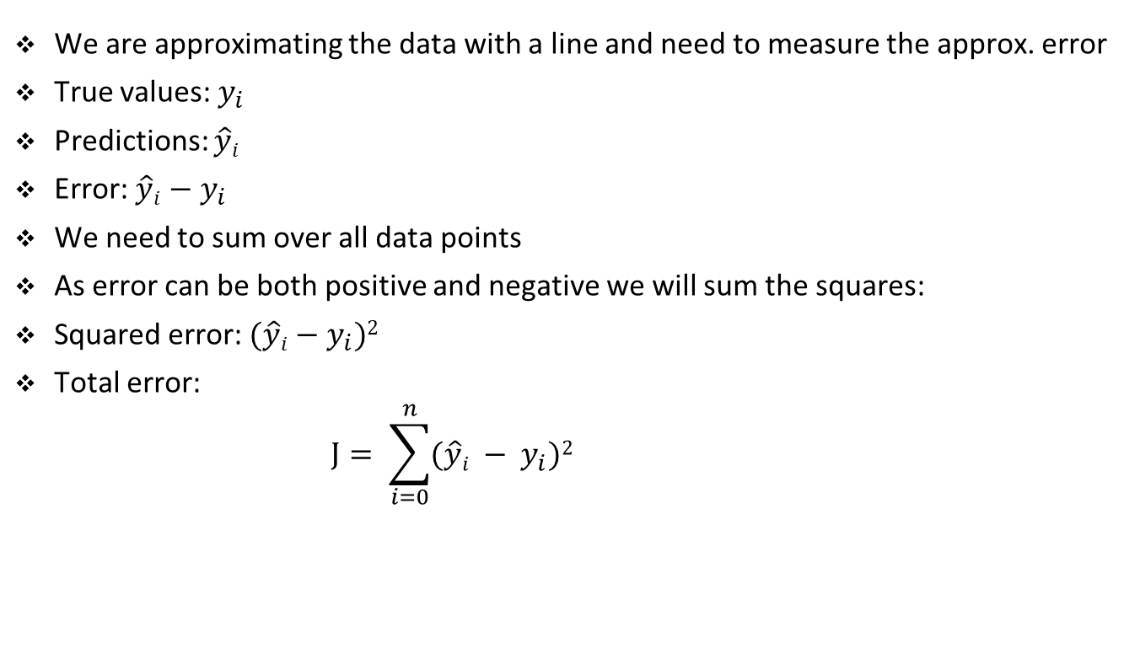
Least squares
We are approximating the data with a line and need to measure the approx. error
True values: $y_{i}$
Predictions: $\hat{y}i$
Error: $\hat{y}i$ $− y_{i}$
We need to sum over all data points
As error can be both positive and negative we will sum the squares:
Squared error: $(\hat{y}i$ $− y_{i})2$
Total error:
$$J= \sum_{i=0}^{n}{(\hat{y}i − y_{i})2 }$$

Slide 22
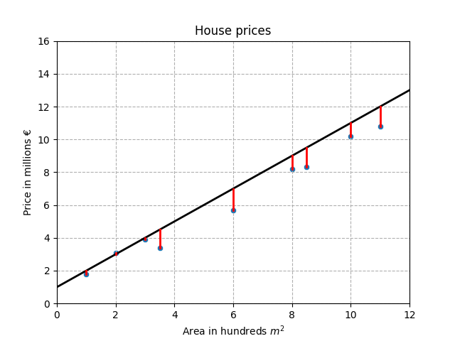
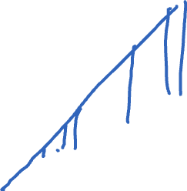
Example of the approximation error
Sum of squared errors

Slide 23
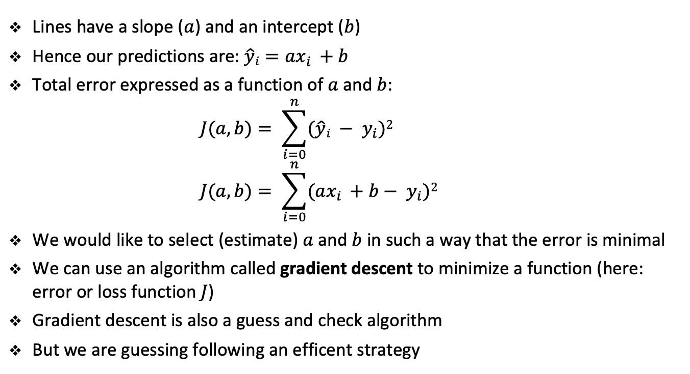
Least squares
Lines have a slope ($a$) and an intercept ($b$)
Hence our predictions are: $\hat{y}i=ax_{i }+b$
Total error expressed as a function of $a$and $b$:
$$J(a, b)= \sum_{i=0}^{n}{(\hat{y}i − y_{i})2 }$$
$$J(a, b)= \sum_{i=0}^{n}{(ax_{i }+b− y_{i})2 }$$
We would like to select (estimate) $a$ and $b$ in such a way that the error is minimal
We can use an algorithm called gradient descent to minimize a function (here: error or loss function $J$)
Gradient descent is also a guess and check algorithm
But we are guessing following an efficent strategy

Slide 24
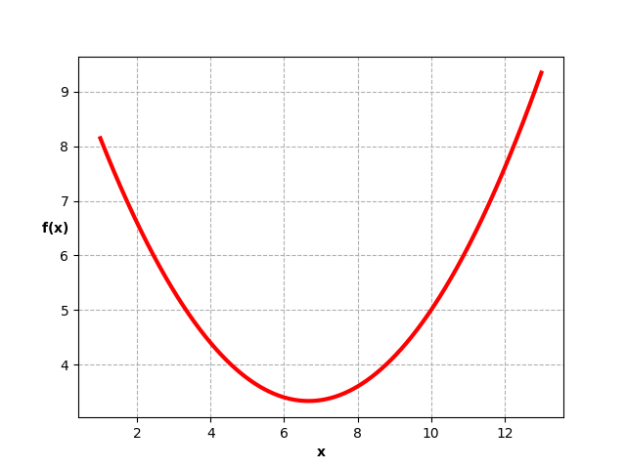

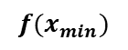
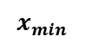
Gradient descent
gradient
new gradient
guess
new gradient
next guess
next guess
stop
$${f(x}_{min})$$
$$x_{min}$$

Slide 25
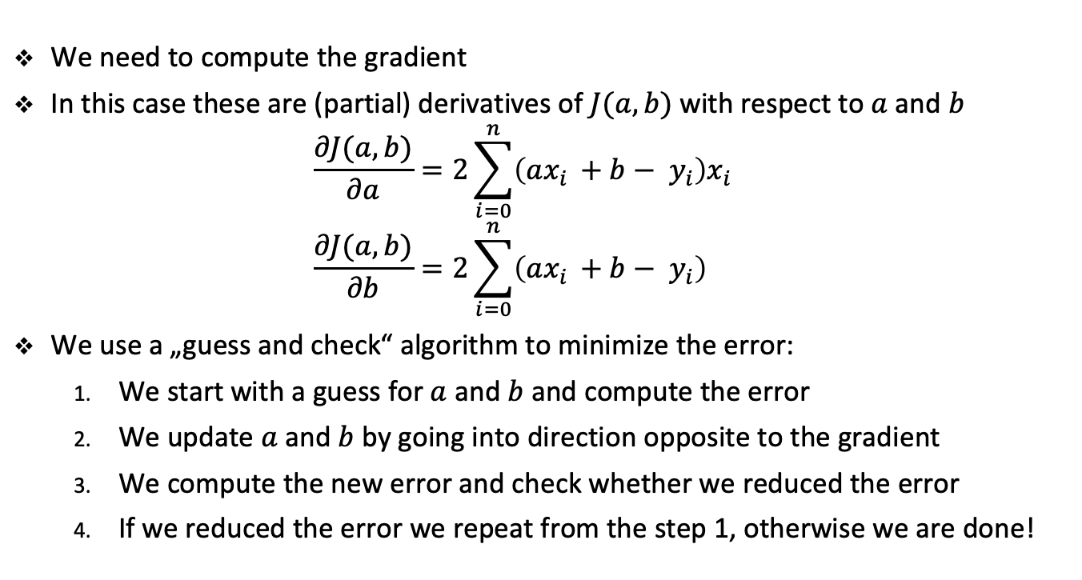
Gradient descent
We need to compute the gradient
In this case these are (partial) derivatives of $J(a, b)$ with respect to $a$ and $b$
$$\frac{∂J(a, b)}{∂a}=2\sum_{i=0}^{n}{\left(ax_{i }+b− y_{i}\right)x_{i} }$$
$$\frac{∂J(a, b)}{∂b}=2\sum_{i=0}^{n}{\left(ax_{i }+b− y_{i}\right) }$$
We use a „guess and check“ algorithm to minimize the error:
We start with a guess for $a$ and $b$ and compute the error
We update $a$ and $b$ by going into direction opposite to the gradient
We compute the new error and check whether we reduced the error
If we reduced the error we repeat from the step 1, otherwise we are done!

Slide 26
Recap of algorithms: Merge sort

Slide 27
Merge sort
We will use a divide-and-conquer approach
We will break the problem into several smaller subproblems (divide)
We will solve subproblems that are easier than the original problem (conquer)
Finally, we will combine the solution to subproblems
Obtaining the solution for the original problem
We will solve the subproblems recursively

Slide 28
Merge sort
Divide-and-conquer for sorting:
If list is of length 0 or 1, already sorted (Base case)
If list has more than one element (Recursive case)
Split into two lists
Sort each sublist
Merge sorted sublists
Look at first element of each sublist
Move smaller to the end of the result list
When one list is empty, just copy the rest of the other list

Slide 29
Merge sort
Divide-and-conquer (split list in half until sublists have only 1 element):
Unsorted
Divide
Unsorted
Unsorted
Divide
Unsorted
Unsorted
Unsorted
Unsorted
Divide
Unsorted
Unsorted
Unsorted
Unsorted
Unsorted
Unsorted
Unsorted
Unsorted
Divide
Conquer
Divide
Merge
Merge
Merge
Merge
Merge
Merge
Merge
Merge

Slide 30
Merge sort
Divide-and-conquer:
Unsorted
Unsorted
Unsorted
Unsorted
Unsorted
Unsorted
Unsorted
Sorted
Sorted
Sorted
Sorted
Sorted
Sorted
Sorted
Sorted
Merge
Merge
Merge
Merge

Slide 31
Merge sort
Divide-and-conquer:
Unsorted
Unsorted
Unsorted
Sorted
Sorted
Sorted
Sorted
Merge
Merge

Slide 32
Merge sort
Divide-and-conquer:
Unsorted
Sorted
Sorted
Merge

Slide 33
Merge sort
Divide-and-conquer:
Sorted

Slide 34
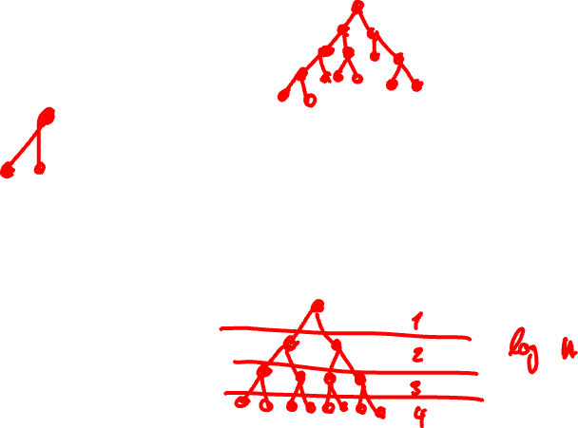
Merge sort
5 | 2 | 4 | 6 | 1 | 3
5 | 2 | 4
6 | 1 | 3
5
2 | 4
6
1 | 3
2
4
1
3

Slide 35
Merge sort
5
6
2
4
1
3

Slide 36
Merge sort
5
2 | 4
6
1
3

Slide 37
Merge sort
5
2 | 4
6
1 | 3

Slide 38
Merge sort
2 | 4 | 5
6
1 | 3

Slide 39
Merge sort
2 | 4 | 5
1 | 3 | 6

Slide 40
Merge sort
1 | 2 | 3 | 4 | 5 | 6

Slide 41
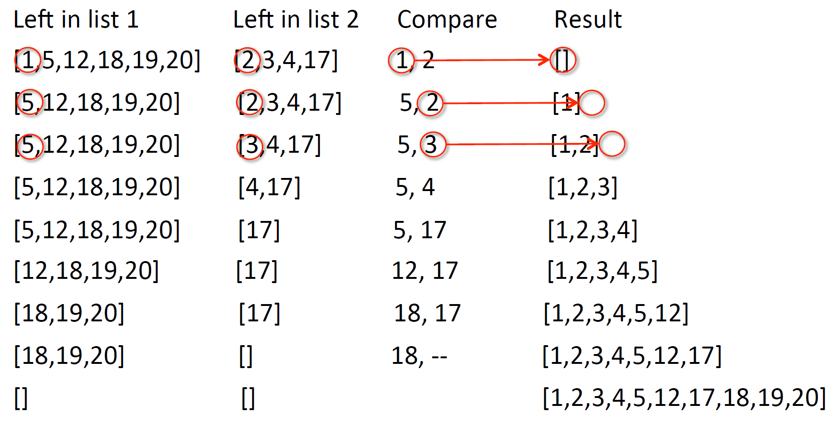
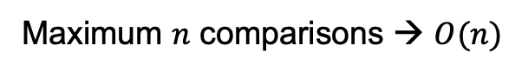
Example of merging
Maximum $n$ comparisons → $O(n)$
Source: Introduction to Computation and Programming using Python, MIT Open Courseware
Notes:
Since each list is sorted, each comparison yields the currently smallest number.

Slide 42
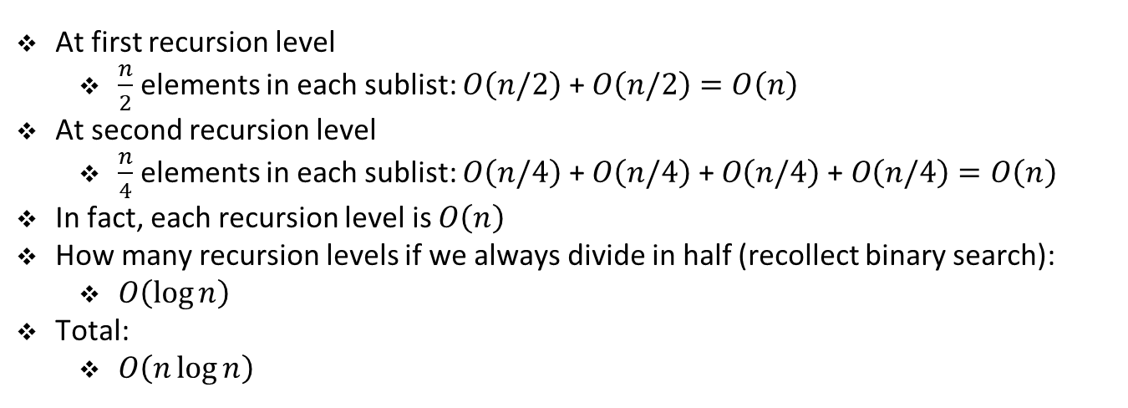
Merge sort
At first recursion level
$\frac{n}{2}$ elements in each sublist: $O\left(n/2\right)$ + $O\left(n/2\right)=O\left(n\right)$
At second recursion level
$\frac{n}{4}$ elements in each sublist: $O\left(n/4\right)$ + $O\left(n/4\right) \text{+ }O\left(n/4\right) \text{+ }O\left(n/4\right)=O\left(n\right)$
In fact, each recursion level is $O\left(n\right)$
How many recursion levels if we always divide in half (recollect binary search):
$O\left(\log{n}\right)$
Total:
$O\left(n\log{n}\right)$

Slide 43
Data structures and algorithms

Slide 44
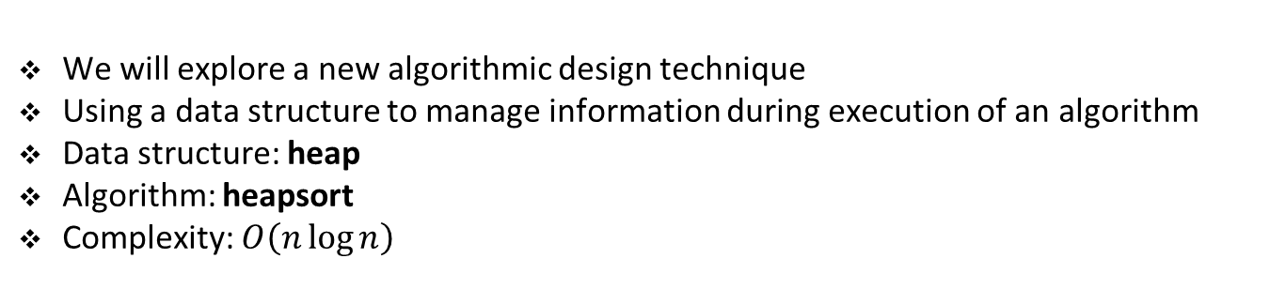
Close relation between data structures and algorithms
We will explore a new algorithmic design technique
Using a data structure to manage information during execution of an algorithm
Data structure: heap
Algorithm: heapsort
Complexity: $O\left(n\log{n}\right)$

Slide 45
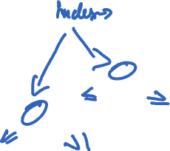
(Binary) heap
0 | 1 | 2 | 3 | 4 | 5 | 6 | 7 | 8 | 9
16 | 14 | 10 | 8 | 7 | 9 | 3 | 2 | 4 | 1
0
16
1
2
14
10
3
4
5
6
8
7
9
3
7
8
9
2
4
1

Slide 46
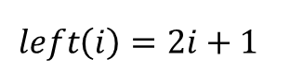
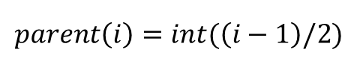
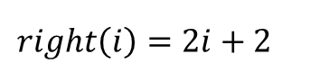
Parent node, left and right nodes
0 | 1 | 2 | 3 | 4 | 5 | 6 | 7 | 8 | 9
16 | 14 | 10 | 8 | 7 | 9 | 3 | 2 | 4 | 1
0
16
1
2
14
10
3
4
5
6
8
7
9
3
7
8
9
2
4
1
$$left\left(i\right)=2i+1$$
$$right\left(i\right)=2i+2$$
$$parent\left(i\right)=int(\left(i−1\right)/2)$$

Slide 47
Parent node, left and right nodes
class Heap():
def __init__(self, a=[], size=10):
self.a = a
self.size = size
def parent(i):
return (i - 1) // 2
def left(i):
return 2 * i + 1
def right(i):
return 2 * i + 2
def size(self):
return self.size
. . .

Slide 48
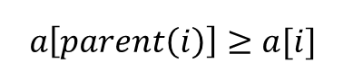
Heap property (max-heap)
0 | 1 | 2 | 3 | 4 | 5 | 6 | 7 | 8 | 9
16 | 14 | 10 | 8 | 7 | 9 | 3 | 2 | 4 | 1
0
16
1
2
14
10
3
4
5
6
8
7
9
3
7
8
9
2
4
1
def check_heap_property(self):
for i in range(1, self.size):
if self.a[i] > self.a[Heap.parent(i)]:
return False
return True
$$a\left[parent\left(i\right)\right]≥a[i]$$
Notes:
Max-heap

Slide 49
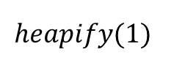
Heapifying
0 | 1 | 2 | 3 | 4 | 5 | 6 | 7 | 8 | 9
16 | 4 | 10 | 14 | 7 | 9 | 3 | 2 | 8 | 1
0
16
1
2
4
10
3
4
5
6
14
7
9
3
7
8
9
2
8
1
$$heapify(1)$$

Slide 50
Heapifying
0 | 1 | 2 | 3 | 4 | 5 | 6 | 7 | 8 | 9
16 | 4 | 10 | 14 | 7 | 9 | 3 | 2 | 8 | 1
0
16
1
2
4
10
3
4
5
6
14
7
9
3
7
8
9
2
8
1
$$heapify(1)$$

Slide 51
Heapifying
0 | 1 | 2 | 3 | 4 | 5 | 6 | 7 | 8 | 9
16 | 4 | 10 | 14 | 7 | 9 | 3 | 2 | 8 | 1
0
16
1
2
4
10
3
4
5
6
14
7
9
3
7
8
9
2
8
1
$$heapify(1)$$

Slide 52
Heapifying
0 | 1 | 2 | 3 | 4 | 5 | 6 | 7 | 8 | 9
16 | 4 | 10 | 14 | 7 | 9 | 3 | 2 | 8 | 1
0
16
1
2
4
10
3
4
5
6
14
7
9
3
7
8
9
2
8
1
$$heapify(1)$$

Slide 53
Heapifying
0 | 1 | 2 | 3 | 4 | 5 | 6 | 7 | 8 | 9
16 | 14 | 10 | 4 | 7 | 9 | 3 | 2 | 8 | 1
0
16
1
2
14
10
3
4
5
6
4
7
9
3
7
8
9
2
8
1
$$heapify(1)$$

Slide 54
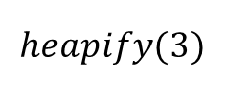
Heapifying
0 | 1 | 2 | 3 | 4 | 5 | 6 | 7 | 8 | 9
16 | 14 | 10 | 4 | 7 | 9 | 3 | 2 | 8 | 1
0
16
1
2
14
10
3
4
5
6
4
7
9
3
7
8
9
2
8
1
$$heapify(3)$$

Slide 55
Heapifying
0 | 1 | 2 | 3 | 4 | 5 | 6 | 7 | 8 | 9
16 | 14 | 10 | 4 | 7 | 9 | 3 | 2 | 8 | 1
0
16
1
2
14
10
3
4
5
6
4
7
9
3
7
8
9
2
8
1
$$heapify(3)$$

Slide 56
Heapifying
0 | 1 | 2 | 3 | 4 | 5 | 6 | 7 | 8 | 9
16 | 14 | 10 | 4 | 7 | 9 | 3 | 2 | 8 | 1
0
16
1
2
14
10
3
4
5
6
4
7
9
3
7
8
9
2
8
1
$$heapify(3)$$

Slide 57
Heapifying
0 | 1 | 2 | 3 | 4 | 5 | 6 | 7 | 8 | 9
16 | 14 | 10 | 4 | 7 | 9 | 3 | 2 | 8 | 1
0
16
1
2
14
10
3
4
5
6
4
7
9
3
7
8
9
2
8
1
$$heapify(3)$$

Slide 58
Heapifying
0 | 1 | 2 | 3 | 4 | 5 | 6 | 7 | 8 | 9
16 | 14 | 10 | 8 | 7 | 9 | 3 | 2 | 4 | 1
0
16
1
2
14
10
3
4
5
6
4
7
9
3
7
8
9
2
8
1
$$heapify(3)$$

Slide 59
Heapifying
def heapify(self, i):
l = Heap.left(i)
r = Heap.right(i)
if l < self.size and self.a[l] > self.a[i]:
largest = l
else:
largest = i
if r < self.size and self.a[r] > self.a[largest]:
largest = r
if largest != i:
self.a[largest], self.a[i] = self.a[i], self.a[largest]
self.heapify(largest)

Slide 60
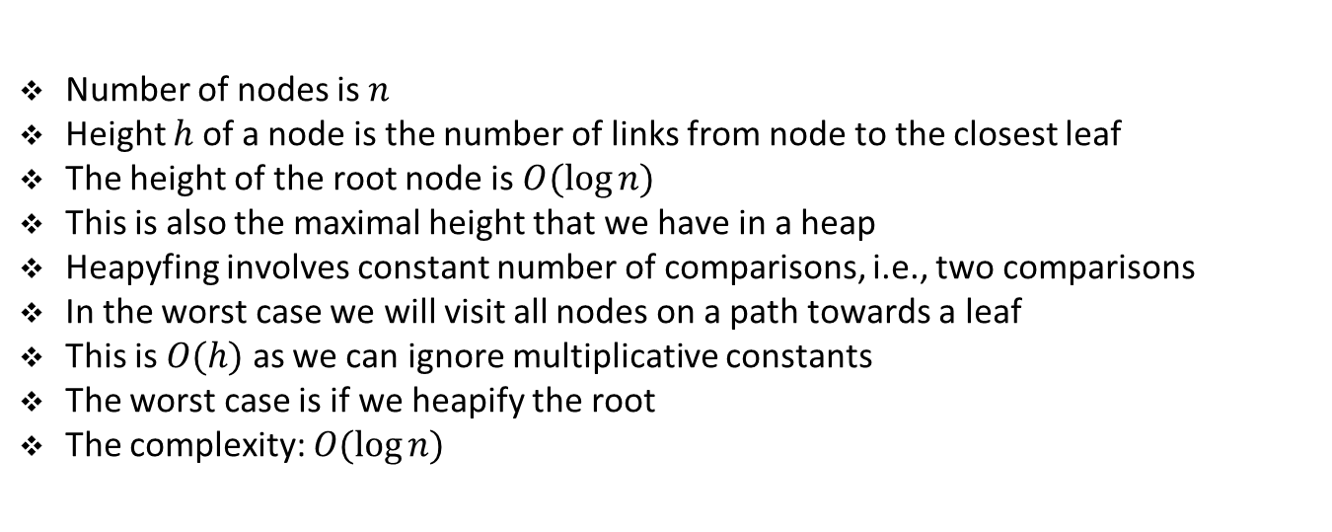
Complexity of heapifying
Number of nodes is $n$
Height $h$ of a node is the number of links from node to the closest leaf
The height of the root node is $O(log⁡n)$
This is also the maximal height that we have in a heap
Heapyfing involves constant number of comparisons, i.e., two comparisons
In the worst case we will visit all nodes on a path towards a leaf
This is $O(h)$ as we can ignore multiplicative constants
The worst case is if we heapify the root
The complexity: $O(log⁡n)$

Slide 61
Exercise

Slide 62
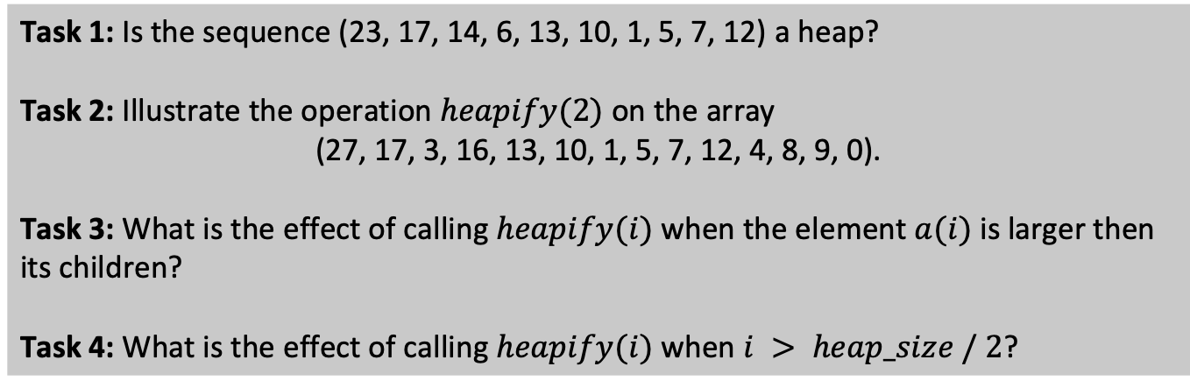
Student task
Task 1: Is the sequence (23, 17, 14, 6, 13, 10, 1, 5, 7, 12) a heap?
Task 2: Illustrate the operation $heapify(2)$ on the array
(27, 17, 3, 16, 13, 10, 1, 5, 7, 12, 4, 8, 9, 0).
Task 3: What is the effect of calling $heapify(i)$ when the element $a(i)$ is larger then its children?
Task 4: What is the effect of calling $heapify(i)$ when $i > heap_size / 2$?

Slide 63
Build heap
0 | 1 | 2 | 3 | 4 | 5 | 6 | 7 | 8 | 9
4 | 1 | 3 | 2 | 16 | 9 | 10 | 14 | 8 | 7
0
4
1
2
1
3
3
4
5
6
2
16
9
10
7
8
9
14
8
7
Lower half are leaf nodes, i.e., no left and right nodes
Hence, they already satisfy heap property (one node heaps)
Hence, we need to heapify only the top half

Slide 64
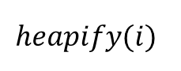
Build heap
0 | 1 | 2 | 3 | 4 | 5 | 6 | 7 | 8 | 9
4 | 1 | 3 | 2 | 16 | 9 | 10 | 14 | 8 | 7
0
4
1
2
1
3
3
4
5
6
2
i
16
9
10
7
8
9
14
8
7
$$heapify(i)$$

Slide 65
Build heap
0 | 1 | 2 | 3 | 4 | 5 | 6 | 7 | 8 | 9
4 | 1 | 3 | 2 | 16 | 9 | 10 | 14 | 8 | 7
0
4
1
2
1
3
3
4
5
6
i
2
16
9
10
7
8
9
14
8
7
$$heapify(i)$$

Slide 66
Build heap
0 | 1 | 2 | 3 | 4 | 5 | 6 | 7 | 8 | 9
4 | 1 | 3 | 14 | 16 | 9 | 10 | 2 | 8 | 7
0
4
1
2
1
i
3
3
4
5
6
14
16
9
10
7
8
9
2
8
7
$$heapify(i)$$

Slide 67
Build heap
0 | 1 | 2 | 3 | 4 | 5 | 6 | 7 | 8 | 9
4 | 1 | 10 | 14 | 16 | 9 | 3 | 2 | 8 | 7
0
4
1
2
i
1
10
3
4
5
6
14
16
9
3
7
8
9
2
8
7
$$heapify(i)$$

Slide 68
Build heap
0 | 1 | 2 | 3 | 4 | 5 | 6 | 7 | 8 | 9
4 | 16 | 10 | 14 | 7 | 9 | 3 | 2 | 8 | 1
0
i
4
1
2
16
10
3
4
5
6
14
7
9
3
7
8
9
2
8
1
$$heapify(i)$$

Slide 69
Build heap
def build_heap(self):
self.size = len(self.a)
for i in range(self.size // 2 - 1, -1, -1):
self.heapify(i)

Slide 70
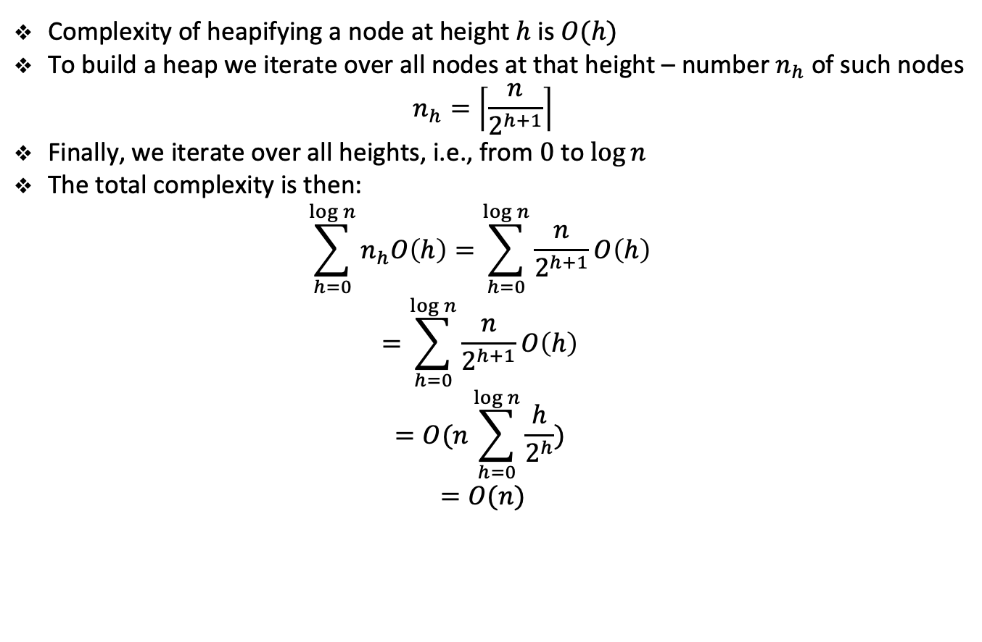
Complexity of heap building
Complexity of heapifying a node at height $h$is $O(h)$
To build a heap we iterate over all nodes at that height – number $n_{h}$ of such nodes
$$n_{h}=\left\lceil \frac{n}{2^{h+1}}\right\rceil$$
Finally, we iterate over all heights, i.e., from $0$ to $log⁡n$
The total complexity is then:
$$\sum_{h=0}^{\log{n}}{n_{h}O\left(h\right)=\sum_{h=0}^{\log{n}}{\frac{n}{2^{h+1}}O\left(h\right) }}$$
$$=\sum_{h=0}^{\log{n}}{\frac{n}{2^{h+1}}O\left(h\right) }$$
$$=O(n\sum_{h=0}^{\log{n}}{\frac{h}{2^{h}}) }$$
$$=O(n)$$
Notes:
Height: number of edges from root to node

Slide 71
Exercise

Slide 72
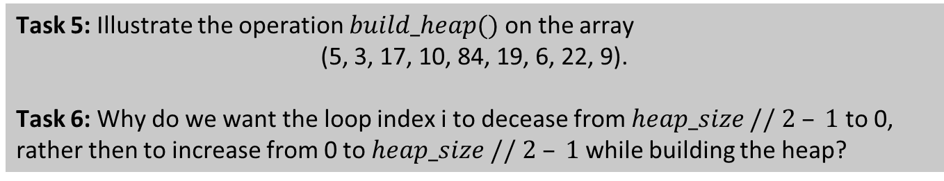
Student task
Task 5: Illustrate the operation $build_heap()$ on the array
(5, 3, 17, 10, 84, 19, 6, 22, 9).
Task 6: Why do we want the loop index i to decease from $heap_size // 2 – 1$to 0, rather then to increase from 0 to $heap_size // 2 – 1$ while building the heap?

Slide 73
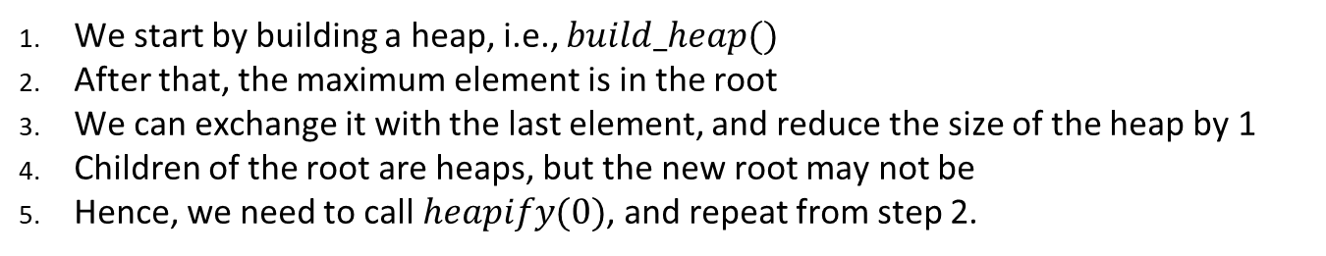
Heapsort
0 | 1 | 2 | 3 | 4 | 5 | 6 | 7 | 8 | 9
4 | 1 | 3 | 2 | 16 | 9 | 10 | 14 | 8 | 7
0
4
1
2
1
3
3
4
5
6
2
16
9
10
7
8
9
14
8
7
We start by building a heap, i.e., $build_heap()$
After that, the maximum element is in the root
We can exchange it with the last element, and reduce the size of the heap by 1
Children of the root are heaps, but the new root may not be
Hence, we need to call $heapify(0)$, and repeat from step 2.

Slide 74
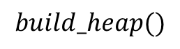
Heapsort
0 | 1 | 2 | 3 | 4 | 5 | 6 | 7 | 8 | 9
16 | 14 | 10 | 8 | 7 | 9 | 3 | 2 | 4 | 1
0
16
1
2
14
10
3
4
5
6
8
7
9
3
7
8
9
2
4
1
$$build_heap()$$

Slide 75
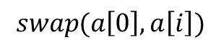
Heapsort
0 | 1 | 2 | 3 | 4 | 5 | 6 | 7 | 8 | 9
1 | 14 | 10 | 8 | 7 | 9 | 3 | 2 | 4 | 16
0
i
16
1
2
14
10
3
4
5
6
8
7
9
3
7
8
9
2
4
1
$$swap(a\left[0\right], a\left[i\right])$$

Slide 76
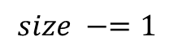
Heapsort
0 | 1 | 2 | 3 | 4 | 5 | 6 | 7 | 8 | 9
1 | 14 | 10 | 8 | 7 | 9 | 3 | 2 | 4 | 16
0
i
1
1
2
14
10
3
4
5
6
8
7
9
3
7
8
9
2
4
16
$$size −=1$$

Slide 77
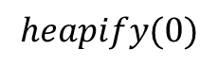
Heapsort
0 | 1 | 2 | 3 | 4 | 5 | 6 | 7 | 8 | 9
1 | 14 | 10 | 8 | 7 | 9 | 3 | 2 | 4 | 16
0
i
1
1
2
14
10
3
4
5
6
8
7
9
3
7
8
9
2
4
16
$$heapify(0)$$

Slide 78
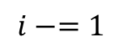
Heapsort
0 | 1 | 2 | 3 | 4 | 5 | 6 | 7 | 8 | 9
14 | 8 | 10 | 4 | 7 | 9 | 3 | 2 | 1 | 16
0
i
14
1
2
8
10
3
4
5
6
4
7
9
3
7
8
9
2
1
16
$$i−=1$$

Slide 79
Heapsort
0 | 1 | 2 | 3 | 4 | 5 | 6 | 7 | 8 | 9
1 | 8 | 10 | 4 | 7 | 9 | 3 | 2 | 14 | 16
0
i
14
1
2
8
10
3
4
5
6
4
7
9
3
7
8
9
2
1
16
$$swap(a\left[0\right], a\left[i\right])$$

Slide 80
Heapsort
0 | 1 | 2 | 3 | 4 | 5 | 6 | 7 | 8 | 9
1 | 8 | 10 | 4 | 7 | 9 | 3 | 2 | 14 | 16
0
i
1
1
2
8
10
3
4
5
6
4
7
9
3
7
8
9
2
14
16
$$size −=1$$

Slide 81
Heapsort
0 | 1 | 2 | 3 | 4 | 5 | 6 | 7 | 8 | 9
1 | 8 | 10 | 4 | 7 | 9 | 3 | 2 | 14 | 16
0
i
1
1
2
8
10
3
4
5
6
4
7
9
3
7
8
9
2
14
16
$$heapify(0)$$

Slide 82
Heapsort
0 | 1 | 2 | 3 | 4 | 5 | 6 | 7 | 8 | 9
10 | 8 | 9 | 4 | 7 | 1 | 3 | 2 | 14 | 16
0
i
10
1
2
8
9
3
4
5
6
4
7
1
3
7
8
9
2
14
16
$$i−=1$$

Slide 83
Heapsort
def heapsort(self):
self.build_heap()
for i in range(len(self.a) - 1, 0, -1):
self.a[0], self.a[i] = self.a[i], self.a[0]
self.size -= 1
self.heapify(0)
Notebook

Slide 84
Heapsort
0 | 1 | 2 | 3 | 4 | 5 | 6 | 7 | 8 | 9
10 | 8 | 9 | 4 | 7 | 1 | 3 | 2 | 14 | 16
0
i
10
1
2
8
9
3
4
5
6
4
7
1
3
7
8
9
2
14
16
complexity

Slide 85
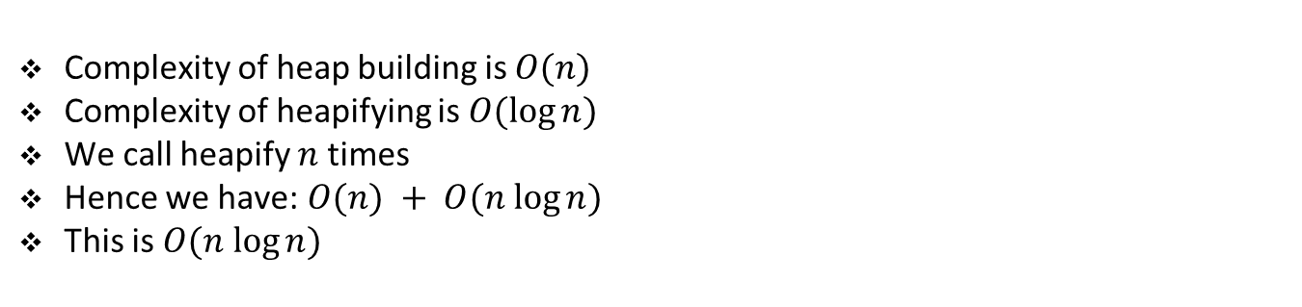
Complexity of heapsort
Complexity of heap building is $O(n)$
Complexity of heapifying is $O(log⁡n)$
We call heapify $n$ times
Hence we have: $O(n) + O(n log⁡n)$
This is $O(n log⁡n)$

Slide 86
Exercise

Slide 87
Student task
Task 7: What is the running time of heapsort on an array that is already sorted in increasing order? What about decreasing order?

